Slide 1
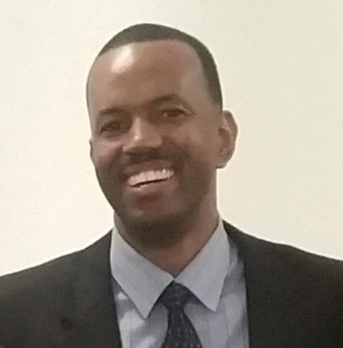
Health Education
Donnie Moore
Email:
Dmoore@madisoncity.k12.al.us
Office Number:
256-772-2547 ext. 80804

Slide 2
HEALTH PURPOSE & FOCUS
Health- the combination of physical, mental/emotional, and social well-being.
Purpose: Health education is designed to investigate theories and practices of wellness in order to be a productive and healthy adult so that you may achieve anything you wish without personal limitations.
Focus: Health literacy - refers to a person’s capacity to learn about and understand basic health information and services, and to use these resources to promote one’s health and wellness.

Slide 3
9 - WEEK PLAN
This course will involve a weekly participation regimen which will include both activity and content knowledge requirements. They will consists of individual and group activities, articles, & videos related to health education.
WEEKLY TOPICS
Week 1 - Introduction to Health
Week 2 - Leading a Healthy Lifestyle
Week 3 - Skills for Healthy Living
Week 4 - Physical Fitness
Week 5 - Nutrition
Week 6 - Substance Abuse & Diseases
Week 7 - Stress
Week 8 - Mental / Emotional Health
Week 9 - Erin’s Law, CPR, Eating Behaviors
Dates subject to change

Slide 4
DAILY THEMES
MONDAY | (INTRODUCTION MONDAYS) - Introduction of Weekly Topic - Lecture, PPT, Assignments, Etc.
TUESDAY | (MENTAL HEALTH TUESDAYS) – Learning and Applying Mindfulness, Meditation, and Reflection Techniques, Journaling, Quiet time, Etc.
WEDNESDAY | (WORKBOOK WEDNESDAYS) – In-class assignments and projects
THURSDAY | (ACTIVITY THURSDAYS) – Applying Health Triangle Activities through Individual and Group Activities; Fitness; Games; Sports, Etc.
FRIDAY | (FINISH-UP FRIDAYS) – Weekly Reviews, Weekly Tests.

Slide 5
DAILY ROUTINES
People Time (No Phones or Technology): The first 5-10 minutes of each class to build relational capacity.
Participation: Daily participation in assignments and activities is required and will heavily affect your grade!!!
Restroom Policy: Use the restroom before class. You get about 4 minutes to use the restroom. No restroom requests during the last 5 minutes of class.
Cell Phones & Restroom: Cell phones will be placed on teacher desk until students return from restroom.

Slide 6
OUTSIDE SPEAKERS
HIV Education - Madison City Schools District Nurse
Presentation
Question/Answer session
Suicide Prevention - Crisis Services Center
Scenario/Module Training
Resources

Slide 7
SUBMITTING ASSIGNMENTS
Schoology - Almost all assignments will be made available on Schoology. Timely submission of assignments is paramount for full credit.
In-class assignments are due before the bell rings at the end of the block unless otherwise specified by the instructor.
Out-of-class assignments are due by the beginning of class on the due date unless otherwise specified by the instructor.
Group activities and assignments -All group members are expected to participate meaningfully and equally within their group.

Slide 8
MAKE-UP WORK
Upon returning to school from an excused absence, MCS make-up work policy allows for three (3) days to make up any missed assignments (including tests). Grades of zero will be posted for assignments missed due to unexcused absences.
Make-up tests will only be given to a student who has an excused absence. It’s the student’s responsibility to make arrangements with and to notify the teacher regarding make up work and tests.

Slide 9
TECHNOLOGY RULES
Concerning the use of cell phones and other electronic devices:
Devices should be on silent and kept in your purse, backpack, or pocket during class unless otherwise instructed. You may not place it on your desk. Parents, guardians, and other family members should call the front office in case of emergency.
ALL cell phones, earbuds, airpods, smartwatches, ipads, etc. should be on silent and on the BLACK counter during instruction time.
***Cell Phones & Restroom: Cell phones will be placed on teacher desk until students return from restroom***

Slide 10
GRADING POLICY
Grades will be earned through an accumulation of points throughout the 9-week period. Percentages will be consistent with Madison City School’s policy.
Test grades account for 70% of your overall grade.
Daily grades account for 30% of your overall grade.

Slide 11
OFFICE HOURS
Daily office hours:
Fall: Tuesdays and Thursdays – 1st Block.
Spring: Tuesdays and Thursdays – 4th Block.
I will be able to answer any questions via Schoology messenger or email.
Please either message me or email me ahead of time any questions or concerns you may have.

